Slide 1
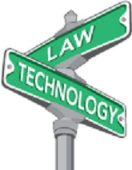
BLUR: Code and Code
How technology is washing away traditional legal boundaries
K. Krasnow Waterman
LawTechIntersect, LLC
Presented to TTI/Vanguard
February 20, 2014

Slide 2
Impact of Tech on Law
Blur
Change to substance, process, philosophy
Faster, cheaper, more efficient
Not Blur

Slide 3
Automating Pre-existing Legal Process
Practice management
Time Keeping
Records Management
Email
Practice
Case & statute databases
Courts
eFiling
eEvidence
Video deposition
NOT BLUR

Slide 4

Let’s talk about BLUR

Slide 5
Boundaries that Blur
Substance
Process
Philosophy
Change to the law or legal meaning of a term
Change to how law or government is performed
Change to our concept of law or government

Slide 6
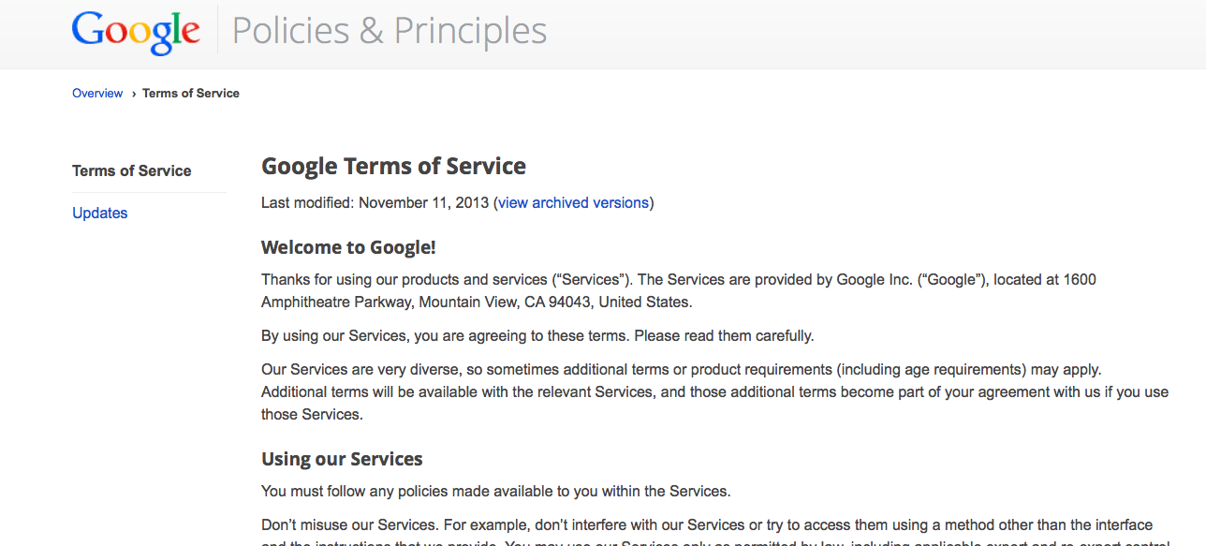
Do you accept Terms of Service on websites?
Substantive Change

Slide 7
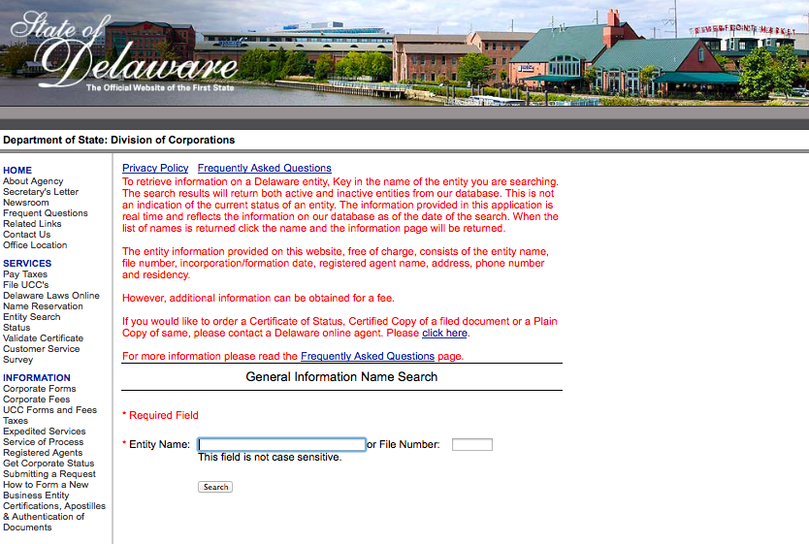
Have you ever been able to avoid using a lawyer because you could look something up online?
Process Change

Slide 8
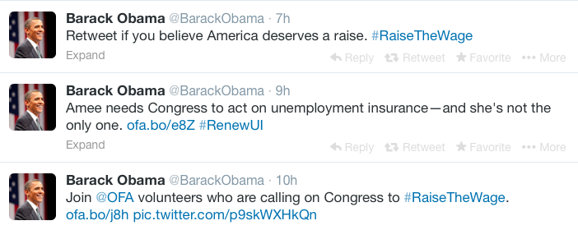
Do you follow the President on Twitter?
Change in Philosophy

Slide 9

Privacy
“A man’s home is his castle”
EXCEPT his..
  1986 - except his yard (Fly-over)
  2007 – email & web log
But not his.. (warrant required)
  1967 – wired phone (Pen register)
  1999 – keystrokes
  2001 – heat signature
  2012 – ongoing auto location (gps tracking device)
And, not sure about his
  2013 – phone metadata
Substance
Notes:
Wiretap: Katz v. US – 389 US 347 (1967)
Flyover: California v. Ciraolo, 476 U.S. 207 (1986),
Heat signature: Kyllo v. US, 121 S. Ct. 2038 (2001)
http://files.grimmelmann.net/cases/Scarfo.pdf (keystroke logger)
GPS tracker – US v. Jones, 132 S.Ct. 945 (2012) (extended us of tracking device; not address tracking cell phone gps)
US v. Forrester, 512 F.3d 500 (9th Cir. 2007) email and web monitoring (required order but not warrant
Conflict re: metadata between Judge Pauley (SDNY) and Judge Leon (DDC)

Slide 10
Genetic Code & Legal Code
1902
1959
1979
1990’s
2013
Discovery of XY
First chromosome anomaly discovered
Case law: “hermaphrodite” born & raised as a man couldn’t marry as a man under “one man, one woman” (Australia)
Increased study of intersex: estimated 2.7MM-10MM in US
Statute: Germany permits third gender designation on birth certificate & passport
Substance
Notes:
Sutton, W. S. On the morphology of the chromosome group in Brachystola magna. Biological Bulletin 4, 24–39 (1902)
McClung, C. E. Notes on the accessory chromosome. Anatomischer Anzeiger 20, 220–226 (1901) (link to article)
———. The accessory chromosome-Sex determinant? Biological Bulletin 3, 43–84 (1902) (link to article)
Blackless, Melanie, Anthony Charuvastra, Amanda Derryck, Anne Fausto-Sterling, Karl Lauzanne, and Ellen Lee. 2000. How sexually dimorphic are we? Review and synthesis. American Journal of Human Biology 12:151-166.
http://www.genetic.org/Knowledge/WhatareXandYChromosomeVariations.aspx
http://www.gendercentre.org.au/resources/polare-archive/archived-articles/intersex-people-and-marriage.htm
http://www.isna.org/faq/frequency – 1 in 100 births – “Total number of people whose bodies differ from standard male or female”
Greenberg, Julie A., Defining Male and Female: Intersexuality and the Collision between Law and Biology. Arizona Law Review, Vol. 41, p. 265, 1999; TJSL Legal Studies Research Paper No. 896307. Available at SSRN: http://ssrn.com/abstract=896307
http://thinkprogress.org/lgbt/2011/06/02/234421/transgender-widow-actually-intersex-court-decision-ignores-nuance-of-sex-gender-and-identity/
http://www.npr.org/blogs/thetwo-way/2013/11/01/242366812/germany-offers-third-gender-option-on-birth-certificates

Slide 11
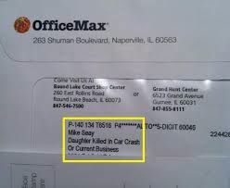
Demographics
Substance

Slide 12
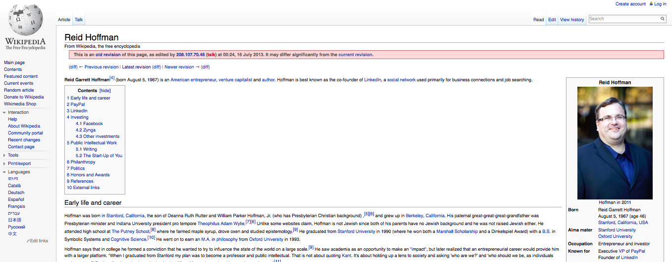
Big Data: Program Code & Code
How do we determine de facto discrimination trends growing in big data?
“Unlike some websites claim, Hoffman is not Jewish since both of his parents have no Jewish background and he was not raised Jewish.”
Process

Slide 13
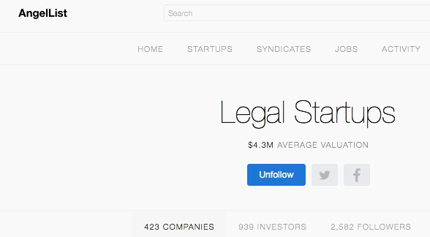
AngelList: 423 Legal Market Entities

Slide 14

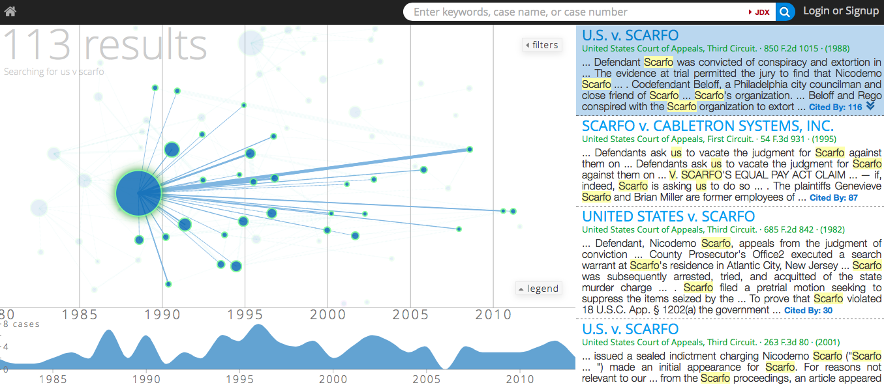
Case Law as Graph
$8.1MM A Round – Feb 2014
Process

Slide 15
The Rise of LegalTech
1970
Legal Journal articles
2011
Reinvent Law
1987
Internat’l Association of AI & Law
1992
LII – Free Access to Law Movement
2014
Data Privacy Legal Hackathon
1981
Legal Tech Conference
1985
“Public Image,” Larry Hunter
1989
“National Security in the Information Age: Applying Mosaic Theory to FOIA”
2001
CIO, Foreign Terrorist Tracking Task Force
2006
“Knowledge Discovery in Corporate Email: the Compliance Bot meets Enron”
2005
Accountable Systems,
DIG, CSAIL, MIT
Process

Slide 16






Scenario
Massachusetts analyst (Mia) sends Request for Information (RFI) to Department of Homeland Security agent (Feddy).
RFI contains criminal history info about a specific person (RBGuy); regulated by Massachusetts General Law 6-172.
MGL
6-172
RFI re:RBGuy
Mia
Feddy

Slide 17
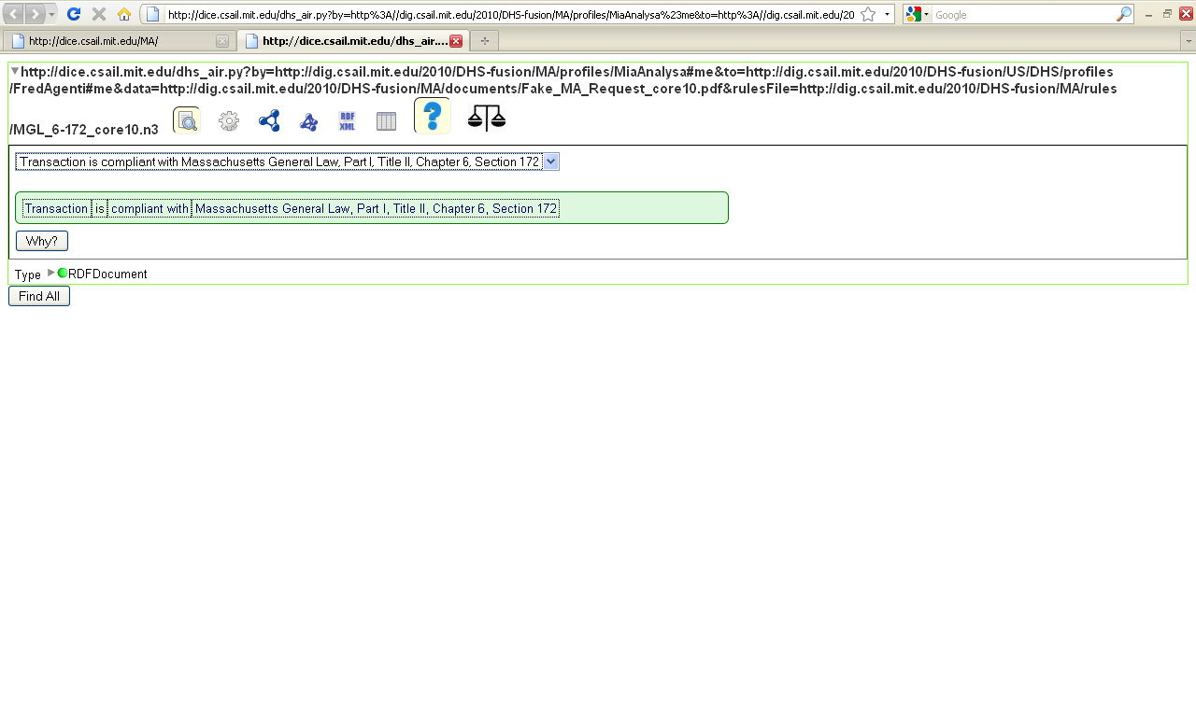
Simple Compliance Answer
“Transaction is compliant with
Massachusetts General Law, Part I, Title II,
Chapter 6, Section 172.”

Slide 18
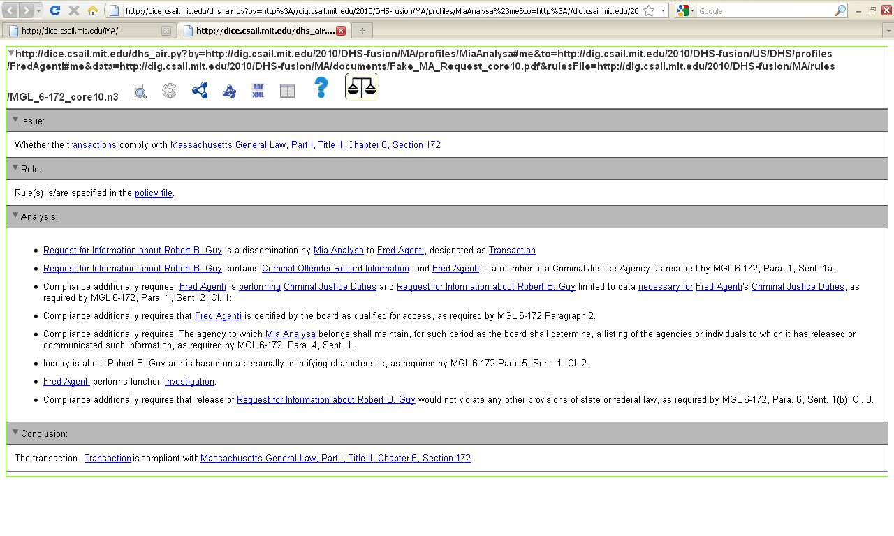
Detailed Explanation
“[Recipient,] Fred Agenti, is a member of a
Criminal Justice Agency…”

Slide 19
Program Code & Code
2005
US Privacy Act converted to a process flow diagram
2009
Map US Privacy Act & others to metadata structure
2010
MIT prototype Accountable System - reasons the US Privacy Act over data transactions and provides plain language explanations.
2013
MIT prototype reasons portion of HIPAA privacy rule over real data and addresses obscured dependencies.
2013
All United States Code published in XML
2014
UK begins “Big Data for Law” project analyzing search and considering law as pattern language
Process
Philosophy
Notes:
http://fcw.com/articles/2013/08/02/us-code-xml.aspx
http://www.fiercebigdata.com/story/big-data-law-government-project-begins/2014-02-10

Slide 20
Text of the Statute

Slide 21
Process Flow Diagram

Slide 22
Mapping of the Statute
Party Subject to the Rule |  |  | RULE Verb | Transaction Verb | Data Subject to the Rule
Party subject to the Rule | Attribute of Party subject to rule | Person Context | Rule Type | Activity Type | Data Category | Special Data Category | Data Context
Government: Federal: Agency |  |  | Prohibited | Share | Person | PII: US Person | Source: System Of Records
People Involved in the Data Transaction |  |  |  |  |  | Circumstances in which the rule applies
Releasing Entity | Attribute of Party subject to rule | Context | Accessing Entity | Attribute of Party subject to rule | Context | Authorized Purpose detail
Government: Federal: Agency |  |  | Person; Government: Federal: Agency
Administrative information that makes it possible to understand precedence, provenance, and linkages
Rule precedence type | "Facilities" rule | Document | Document Citation | Document sub-Reference | Dated
1.2a: Federal Statute |  | The Privacy Act | The Privacy Act, 5 USC § 552a | (b)
Administrative information that makes it possible to understand precedence, provenance, and linkages
Record Number | Old Record Numbers | Linked to Rule Name | Linked to Records | Link Reason | Changed Perspective Flag | Perspective
180001 |  | 1) Definitions: Agency, System of Records, Record |  | 1) AND,

Slide 23



Context Data Required
MGL 66A-1
(Definitions)
Cross-Ontology
KB
MGL
6-172
MGL
6-172
MGL
Ontology
Certified
List
Policies
Org. Admin.
MA
Reasoner
MD
User Profiles
User Docs
User Profiles
Policies
Mia
RFI
Maury
MDCCL
12.15.01.03
(Definitions)
RBGuy
MDCCL
Ontology

Slide 24
Computing Law
Startup converting case law unstructured text to structured
Linking things and the Law that relates to them
(LII, 2013/2014)
Combining system capability for brute force (Watson) & nuanced interaction (MIT)
Law as pattern language (UK)
Notes:
not Suskind’s expert system
If systems can handle 3rd year law student/1st year lawyer, what will bridge the gap to grey beards?

Slide 25
Near term
Data requests - What if my system and your system can negotiate a data contract?
Future
Contracts – What if our systems can negotiate other contracts? (Or partial contracts?)
What if government can produce reports accounting for all data usage (purpose, parties, volume, etc.)
What if systems can find and compute law for you?

Slide 26
Jurisdiction: Zip Code & Legal Code
Substance:
Philosophy:
Can a lawyer telecommute from a location in which he is not licensed? YES
Process: Can a prosecutor in NJ serve a criminal subpoena on a student in MA to find out if the student’s project traversed NJ servers? STAY TUNED
Whose law applies when data is split and traverses through many countries? (Should we direct packets or change the meaning of jurisdiction?)
Is data transferred to every location where someone can view it on a portal or web screen? YES
Process:
What is the authority for establishing law if not jurisdiction?
Is this the basis for stateless currency?

Slide 27
Impact of Availability
What is the practice of law?
Eliminating specialties that the public can now perform (e.g., looking up real estate records)
What is the role of criminal justice?
Changing notion of rehabilitation because the record is persistent & available
How public should our court system be?
Anonymizing sensitive personal information in court records
Philosophy

Slide 28
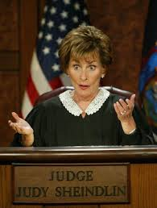
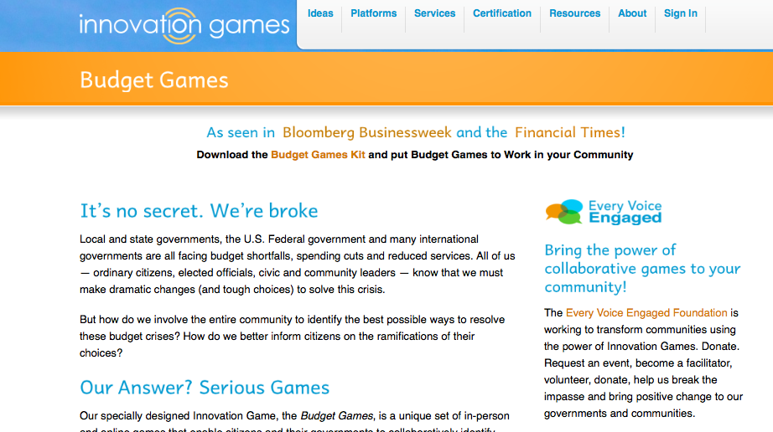

Collaborative Government
Judge Judy
Budget Games
Legal Hackathons
GPSJury
Philosophy

Slide 29
Speed of Blur
Jan 19
Privacy: SCOTUS announces it will hear two cases on warrantless cell phone search
Feb 6
Code: UK announces “Big Data for Law” initiative
Feb 7
Code: ReInvent Law Conference – 1400 participants
Feb 8/9
Code: Data Privacy Legal Hackathon – Producing new privacy technologies (encrypted communications& privacy policy visualization)
Feb 13
Gender: Texas Court of Appeals overturns decision invalidating the marriage of an intersex widow
Jurisdiction: Received email notice of Tidbit case
Notes:
http://thinkprogress.org/lgbt/2011/06/02/234421/transgender-widow-actually-intersex-court-decision-ignores-nuance-of-sex-gender-and-identity/
http://bigstory.ap.org/article/court-revives-transgender-widows-legal-fight

Slide 30
Thank you

Slide 31









Bio - K. Krasnow Waterman
Current:
Global Head Anti-Money Laundering & Sanctions Infrastructure, Citigroup
CIO Foreign Terrorist Tracking Task Force, Department of Justice
Assistant Dean University of Arizona, Law
Litigator Brown & Bain
System design & IT Mgt JPMorgan & IBM
CEO LawTechIntersect, LLC
Co-Investigator Big Data for Law National Archives, UK
Advisory Board, Prevoty, Tengah
Visiting Fellow MIT, Decentralized Information Group, CSAIL
Former:
Founder, Linked Data Ventures

